Slide 1
Citi program registration guide

Slide 2
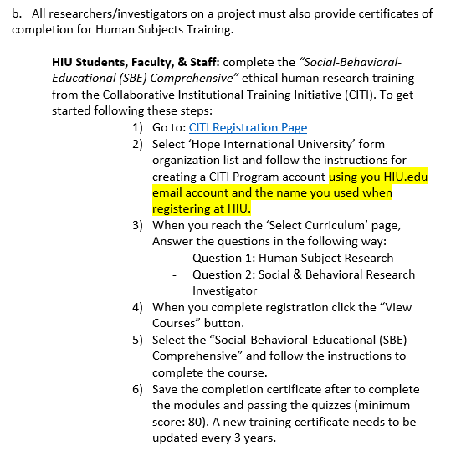

After Reading the IRB Handbook Click on the Link: “CITI Registration PAGE”

Slide 3
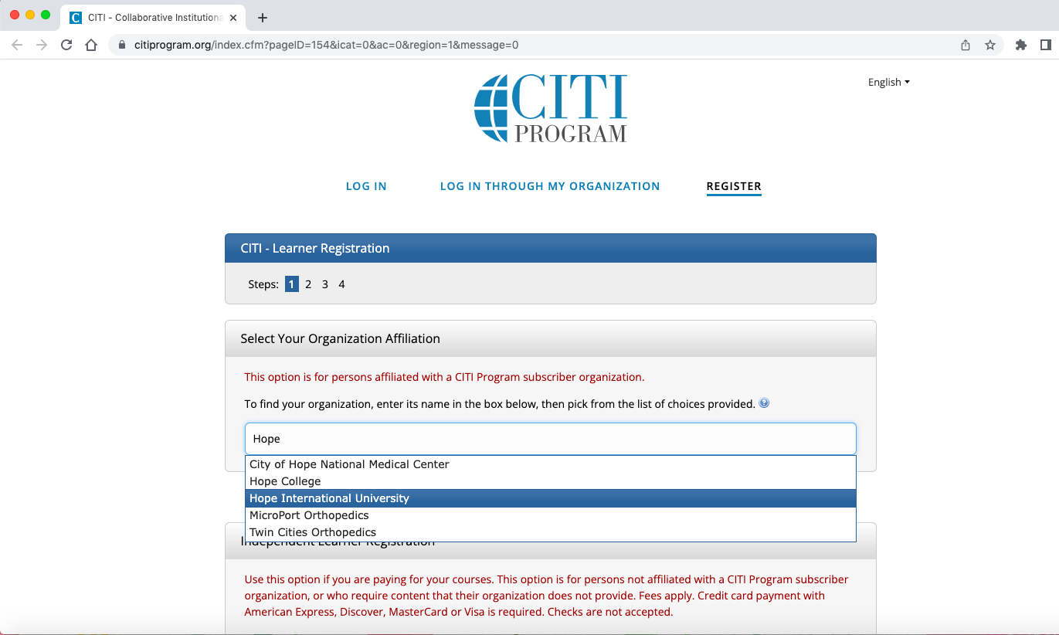
Select Hope International University from the drop-down menu

Slide 4
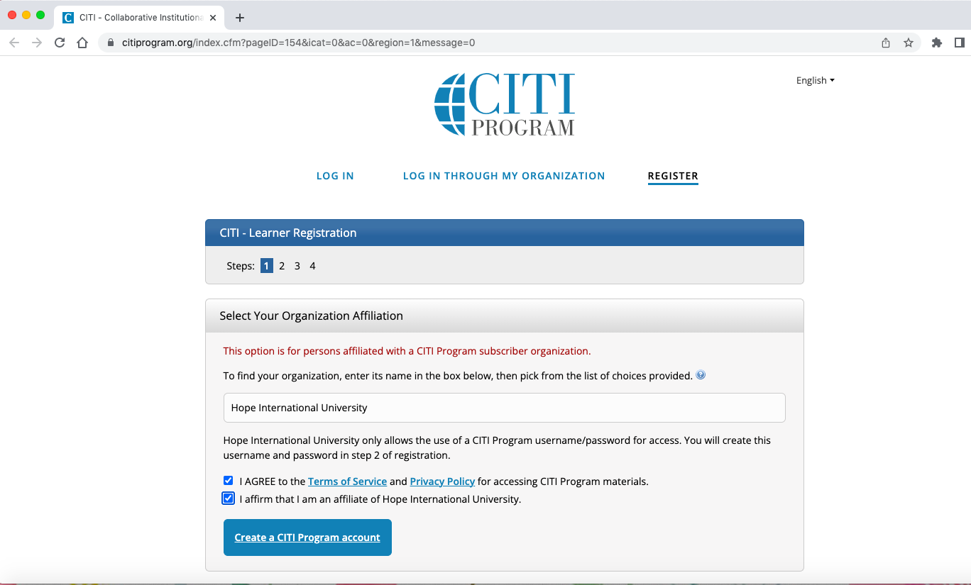
Check the two boxes and then click “Create a CITI Program account”

Slide 5
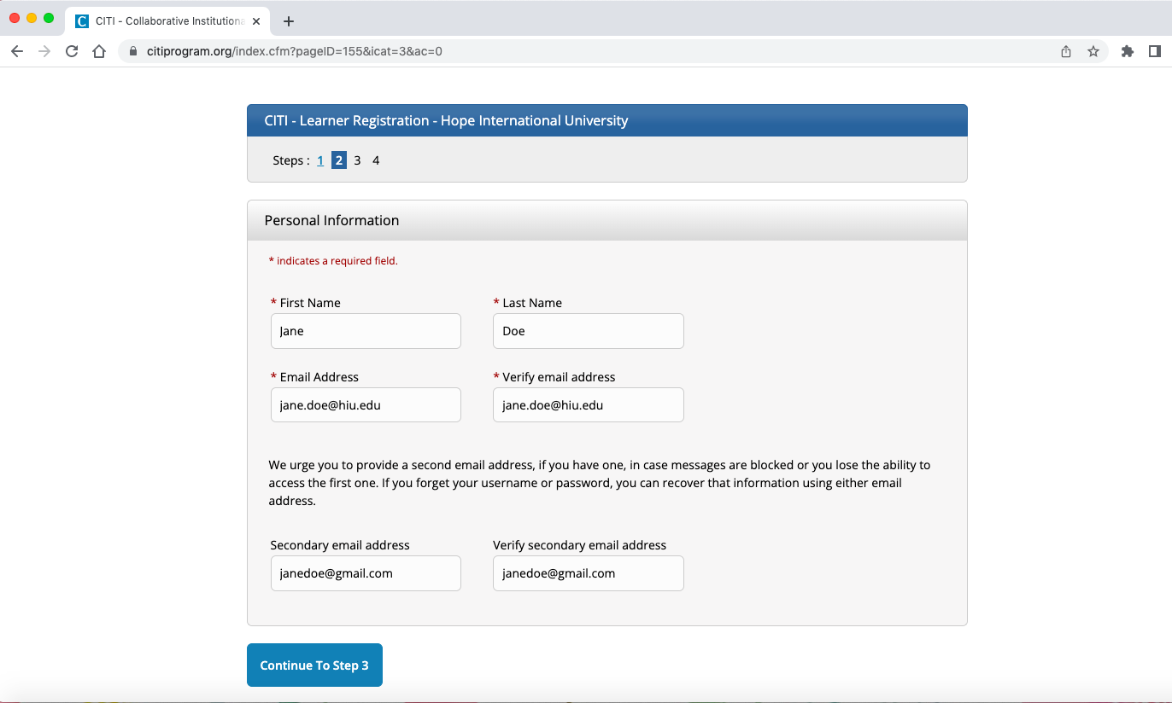
Fill out your name and email address then press “Continue to Step 3”

Slide 6
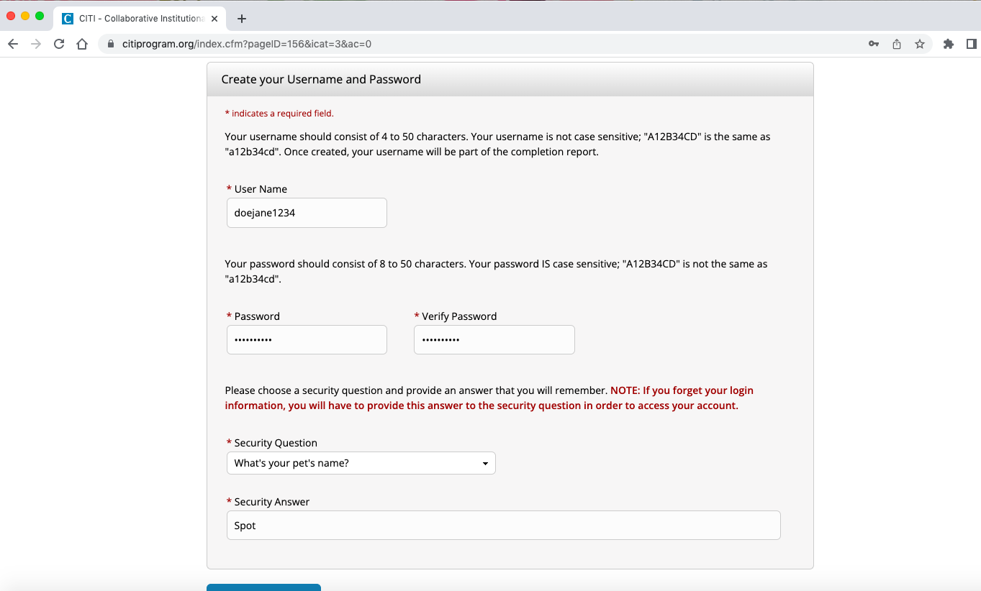
Create your username, password and Security Question/Answer, then continue to step 4

Slide 7
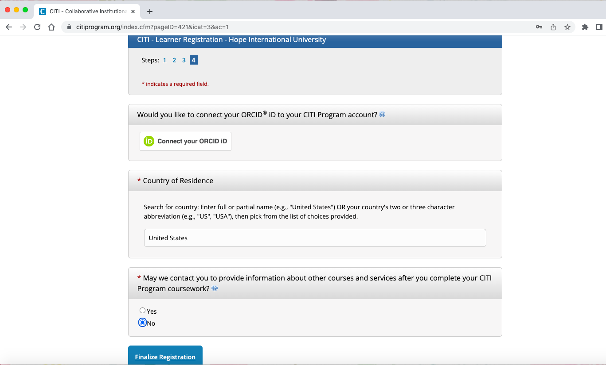
Select your Country of Residence and your contact preference, then click “Finalize Registration”

Slide 8
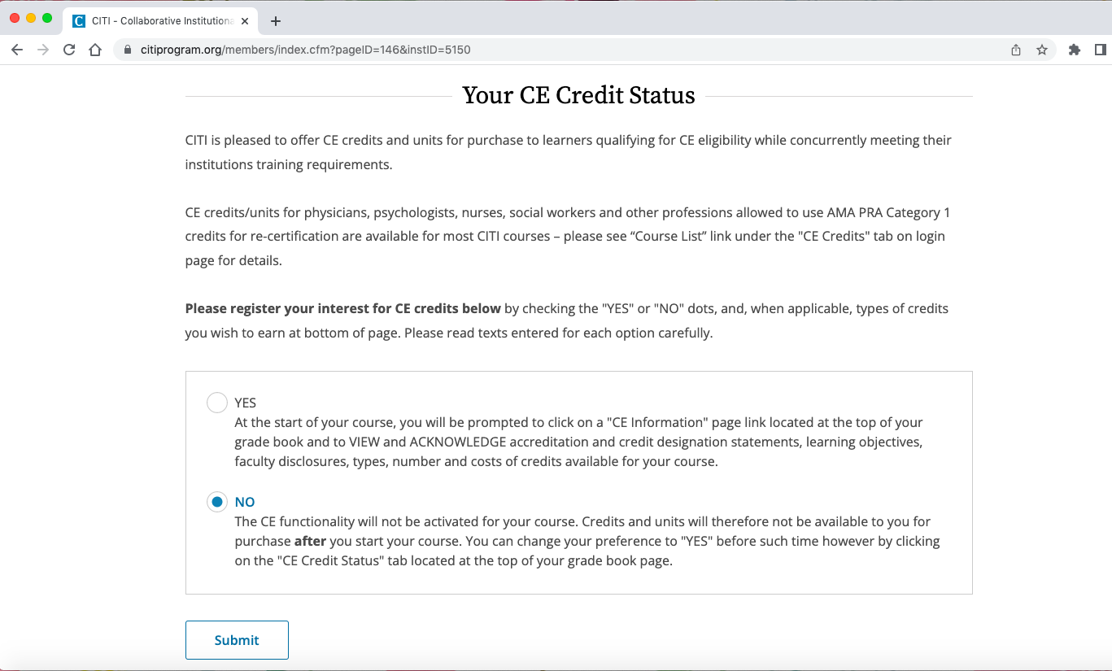
Select “NO” if you do not wish to purchase CE credits. CE credits are not required to meet university requirements for this training

Slide 9
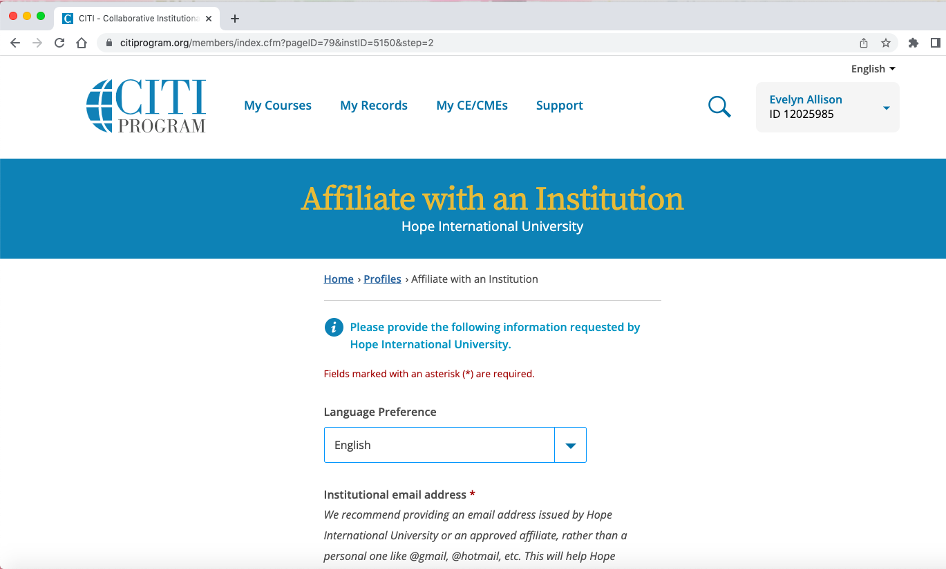
Select language preference

Slide 10
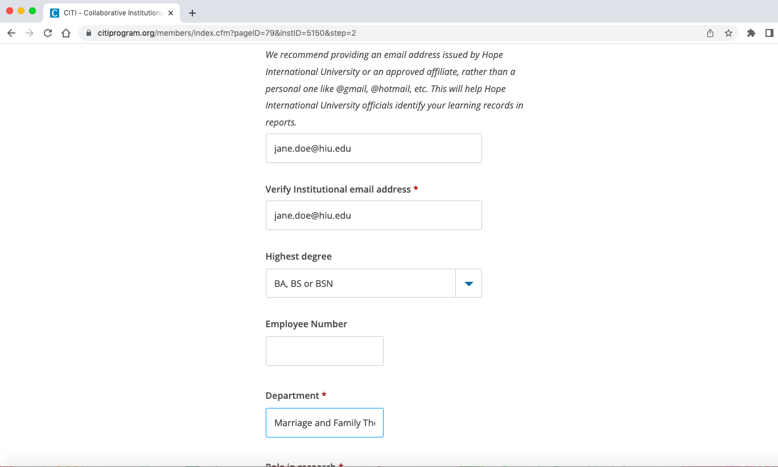
Put in your HIU email address, select your highest degree, and indicate your department

Slide 11
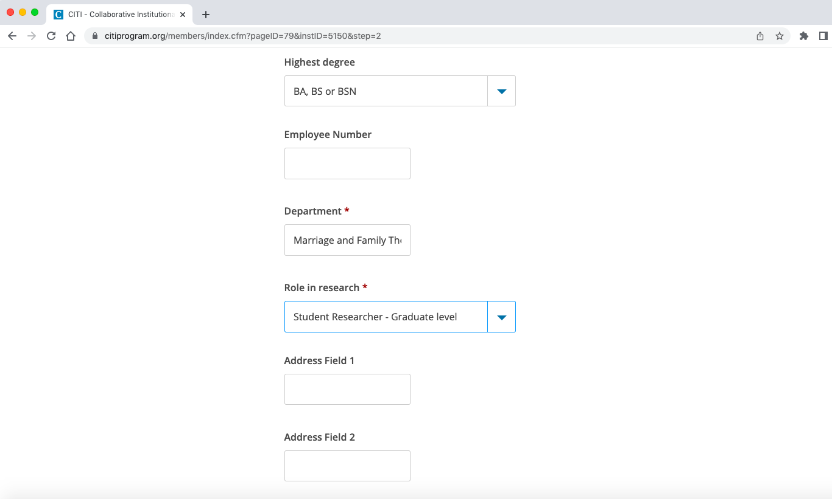
Select your role in the research

Slide 12
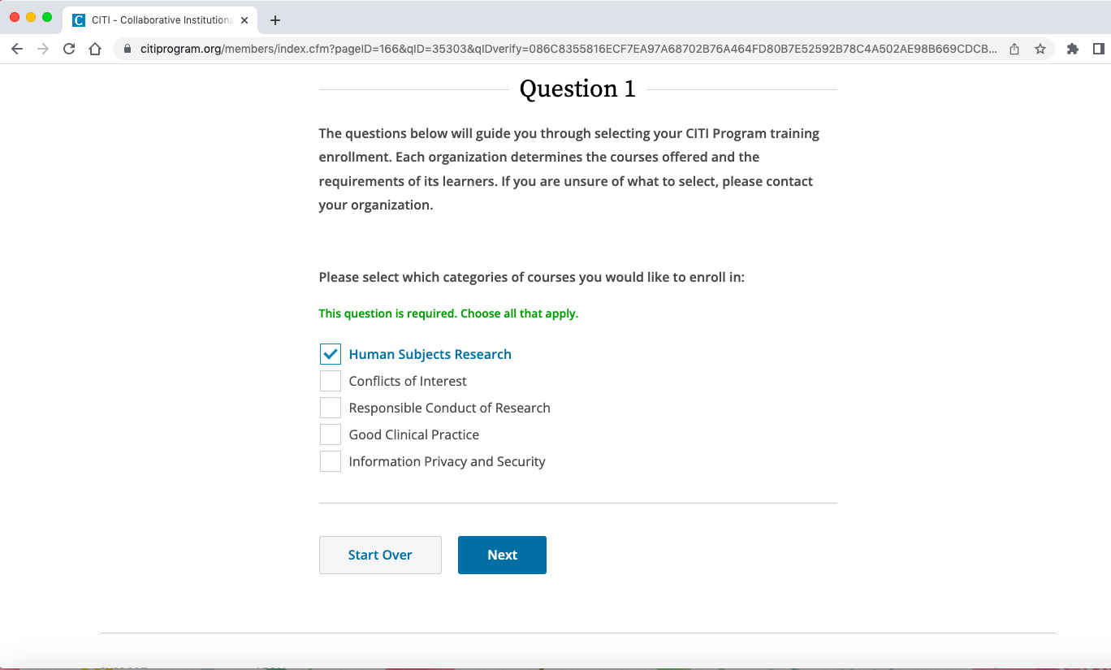
When selecting your training enrollment, select “Human Subjects Research” for Question 1

Slide 13
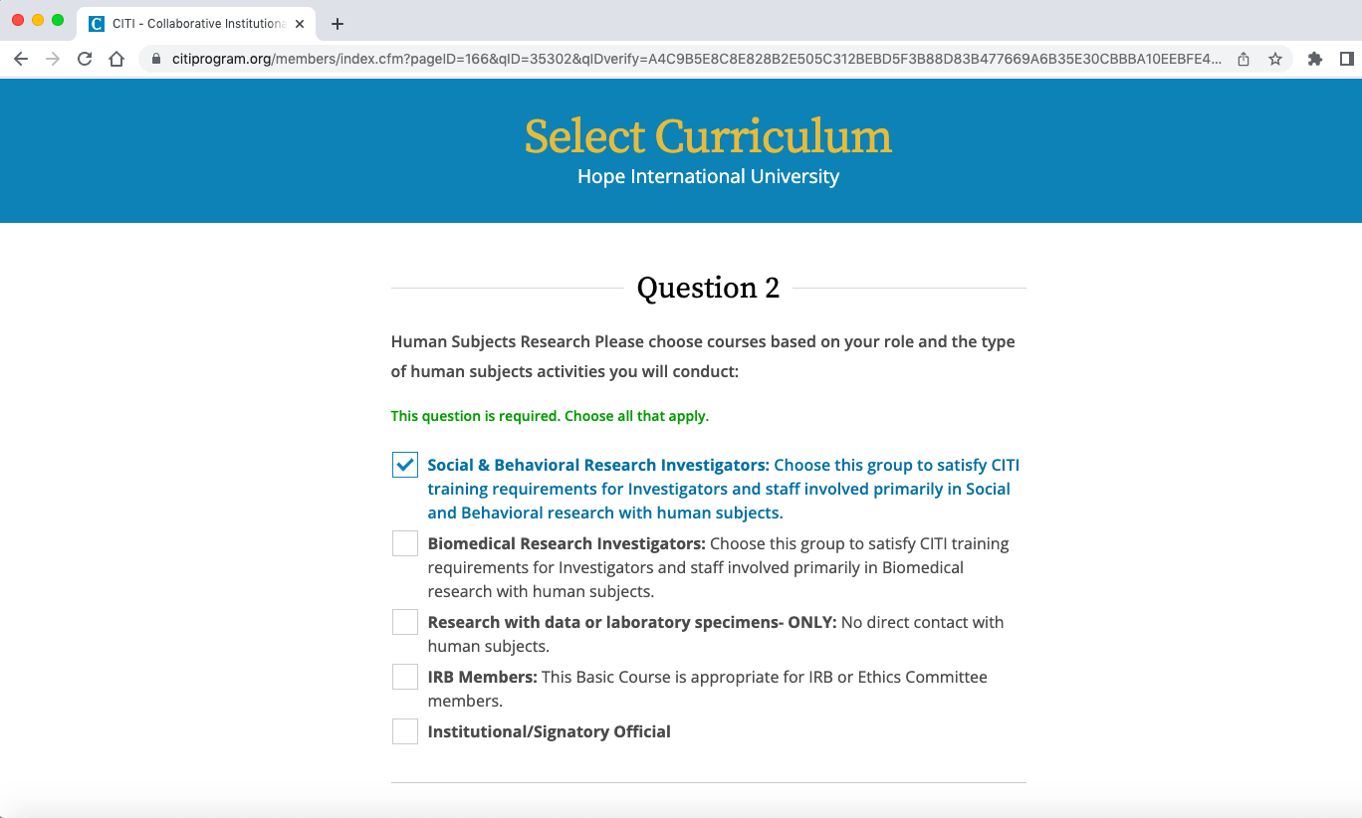
For Question 2, select “Social & Behavioral Research Investigators"

Slide 14
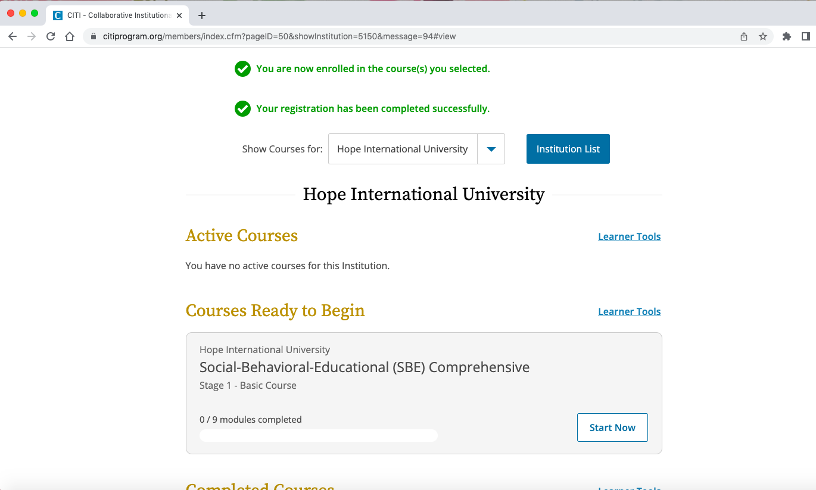
Congratulations! You are now finished with enrollment and can begin taking courses.

